Slide 1

SMART RESUME ANALYSIS AND JOB MATCHING SYSTEM USING NATURAL LANGUAGE PROCESSING
DSA0306-NATURAL LANGUAGE PROCESSING
Supervised By : KUMARAGURUBARAN T
Presented By :
P.MUNI KARTHIK(192425061)
Y.SRAVAN KUMAR(192472289)
K.KALYAN(192425301)
N.VENKATA SIVA(192472236)

Slide 2


ABSTRACT
Finding suitable jobs based on candidate skills is challenging.
Traditional job portals mainly use keyword matching.
Keyword matching may produce irrelevant job recommendations.
The proposed system uses Natural Language Processing (NLP).
The system analyzes resumes and job descriptions.
Resume text is extracted and preprocessed.
Important skills are identified from resumes.

Slide 3
INTRODUCTION
Online recruitment platforms contain many job postings.
Candidates submit resumes containing skills, education, and experience.
Resumes are usually unstructured text documents.
Manual comparison of resumes and job descriptions is time-consuming.
Traditional systems mainly depend on keyword matching.
NLP can process and analyze textual information.
NLP can help extract relevant skills from resumes.
NLP can identify required skills from job descriptions.

Slide 4
OBJECTIVES
To analyze resumes using Natural Language Processing.
To extract relevant information from resumes.
To identify candidate skills.
To analyze job descriptions using NLP.
To identify required job skills.
To compare candidate skills with job requirements.
To calculate a resume-job matching score.
To recommend suitable jobs.

Slide 5
PROPOSED SYSTEM
Manual resume analysis is time-consuming.
Recruiters and candidates deal with large amounts of text.
Traditional systems depend mainly on exact keyword matching.
Exact keyword matching may miss relevant skills.
Different terms may represent similar skills.
Job seekers may receive irrelevant job recommendations.

Slide 6


PROBLEM STATEMENT
Manual interpretation of property dispute judgments is time-consuming and complex.
Legal documents often contain ambiguous terms that lead to misunderstanding and incorrect analysis.
Traditional systems lack accurate grammatical and semantic analysis of legal text.
There is a need for an automated system to improve legal judgment interpretation and dispute analysis.

Slide 7
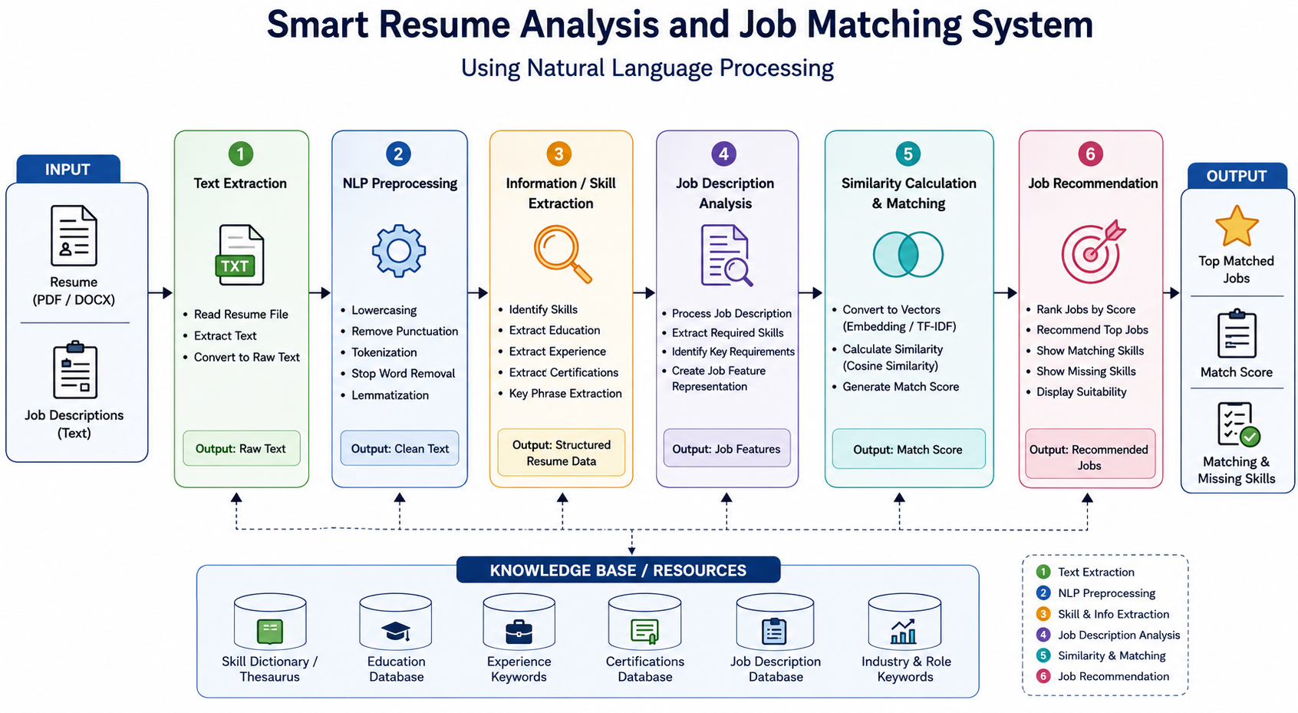
SYSTEM ARCHITECTURE

Slide 8
MODULE 1 – NLP TEXT PREPROCESSING
Algorithm used: Tokenization and Stop-Word Removal
Points:
Accept the extracted resume text as input.
Apply NLP text preprocessing techniques.
Use Tokenization to divide the resume into individual words/tokens.
Use Stop-Word Removal to remove common words such as the, is, and, of.
Prepare clean text for further NLP analysis.
Preserve important technical terms and skill-related words.
Output:
Cleaned and tokenized resume text.

Slide 9

MODULE 2 – NLP-BASED SKILL EXTRACTION
Algorithm used: TF-IDF
Points:
Take the preprocessed resume text as input.
Convert the text into numerical feature representations.
Apply TF-IDF (Term Frequency–Inverse Document Frequency).
Calculate the importance of words and terms in the resume.
Give higher importance to relevant terms such as technical skills.
Identify important resume features for candidate profiling.
Output:
Important skills and resume features.

Slide 10
MODULE 3 – SEMANTIC RESUME–JOB MATCHING
Algorithm used: Sentence-BERT (SBERT)
This should be your main advanced NLP module.
Take the candidate's resume information and job description as input.
Convert both texts into semantic representations.
Apply Sentence-BERT (SBERT) to generate sentence embeddings.
Capture the contextual meaning of resume and job-description text.
Compare the semantic representations of the candidate and job.
Identify whether the candidate's profile is relevant to the job requirements.

Slide 11
MODULE 4 – NLP-BASED JOB RECOMMENDATION
Algorithm used: Cosine Similarity
Take the resume and job embeddings generated by SBERT.
Represent each resume/job profile as a numerical vector.
Apply Cosine Similarity to measure semantic similarity.
Generate a matching score between the candidate and each job.
Compare similarity scores across available jobs.
Recommend the jobs having the highest matching scores.

Slide 12
RESULTS AND DISCUSSION
Resume text was successfully extracted.
Resume text was successfully preprocessed.
Important skills were identified.
Job descriptions were analyzed.
Required job skills were identified.
Resume and job requirements were compared.
Match scores were generated.
Suitable jobs were ranked.

Slide 13
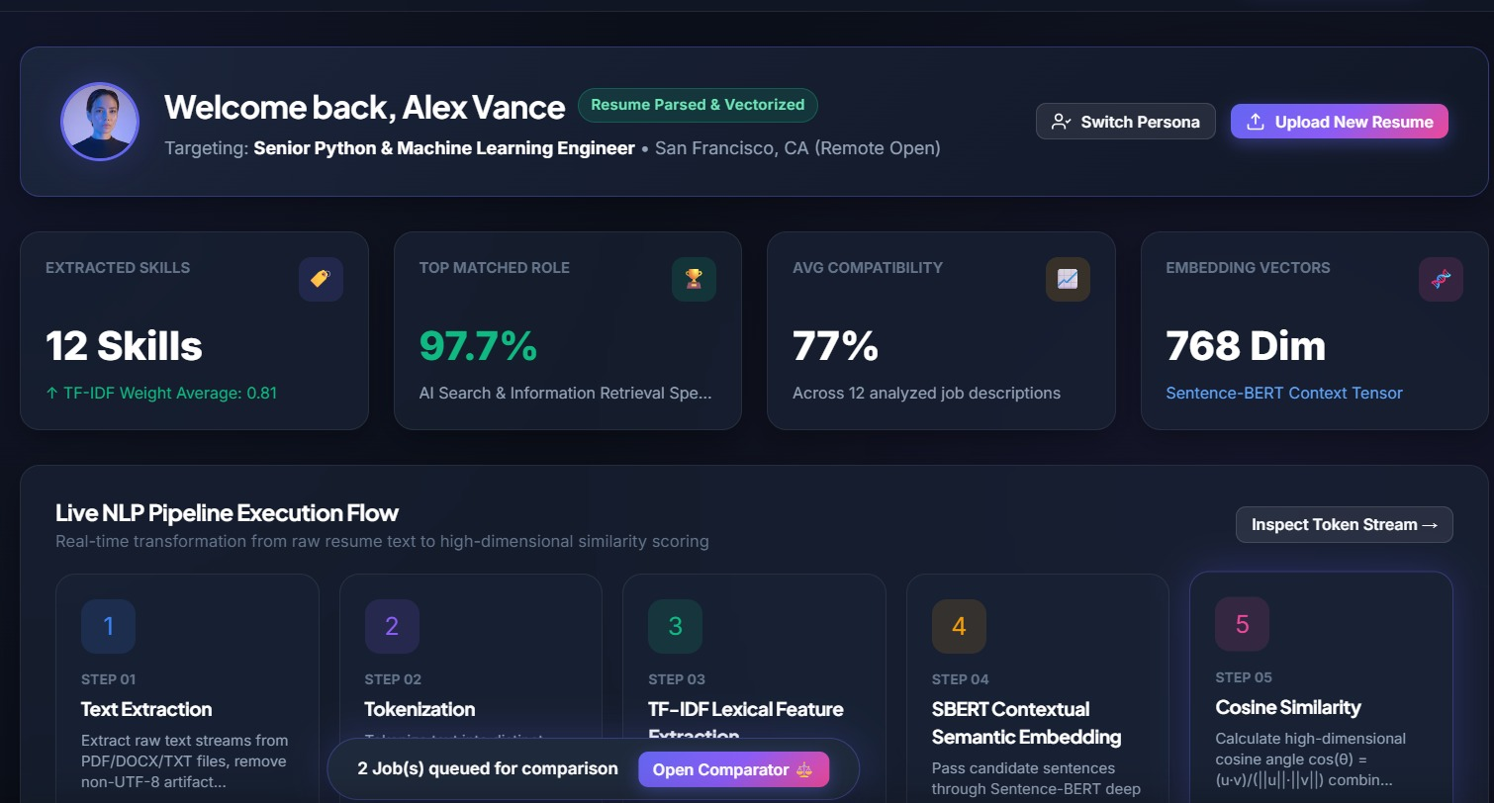
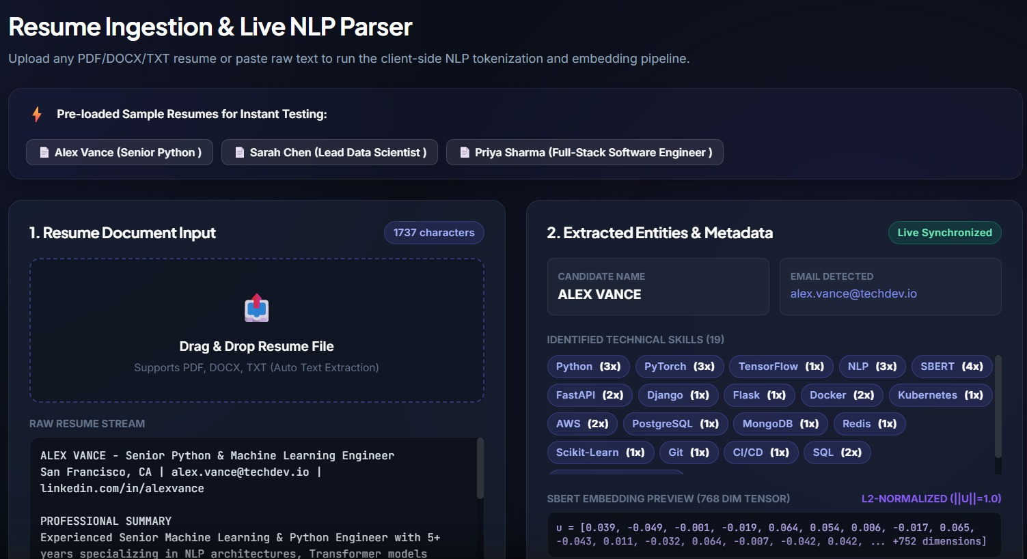
OUTPUT

Slide 14
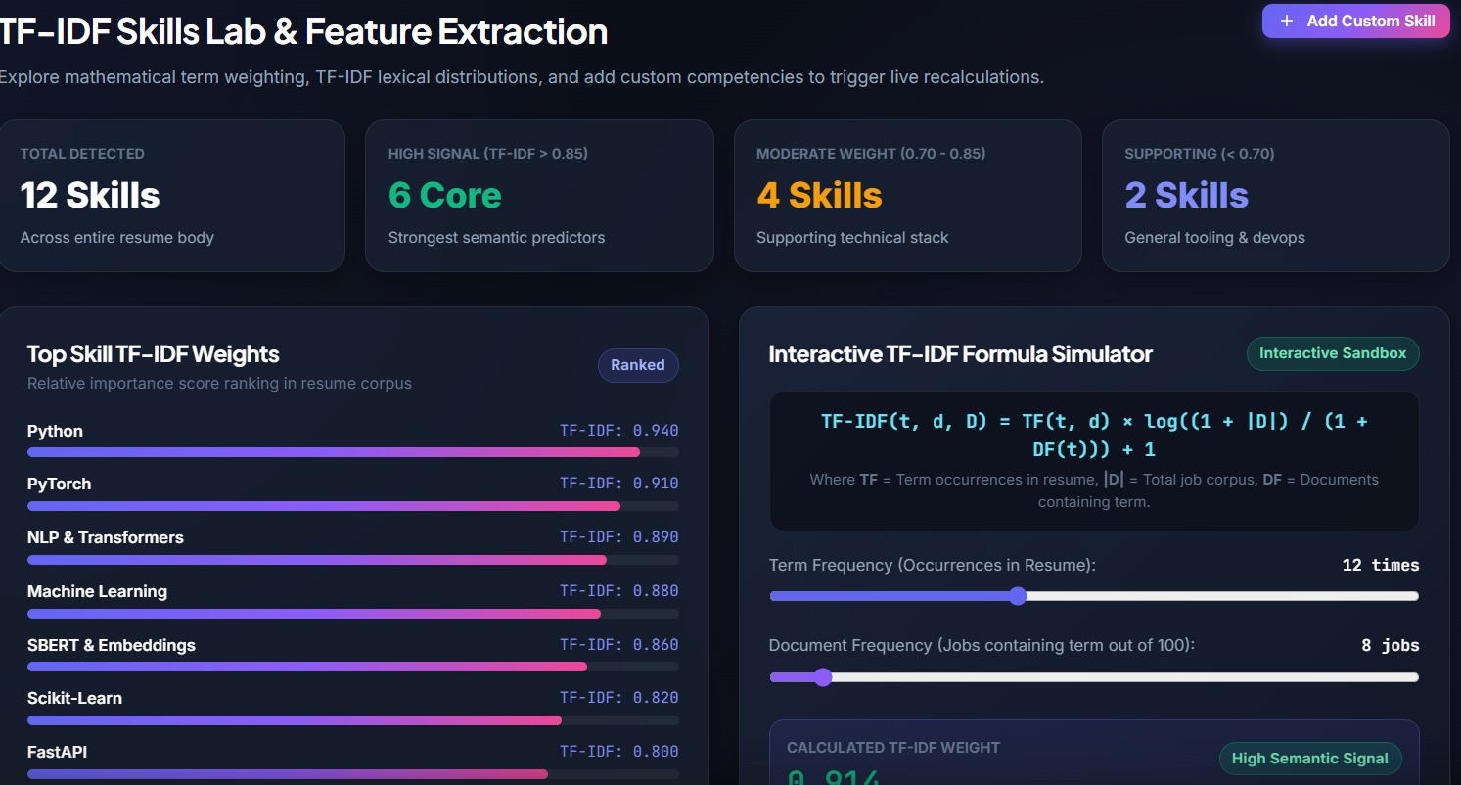
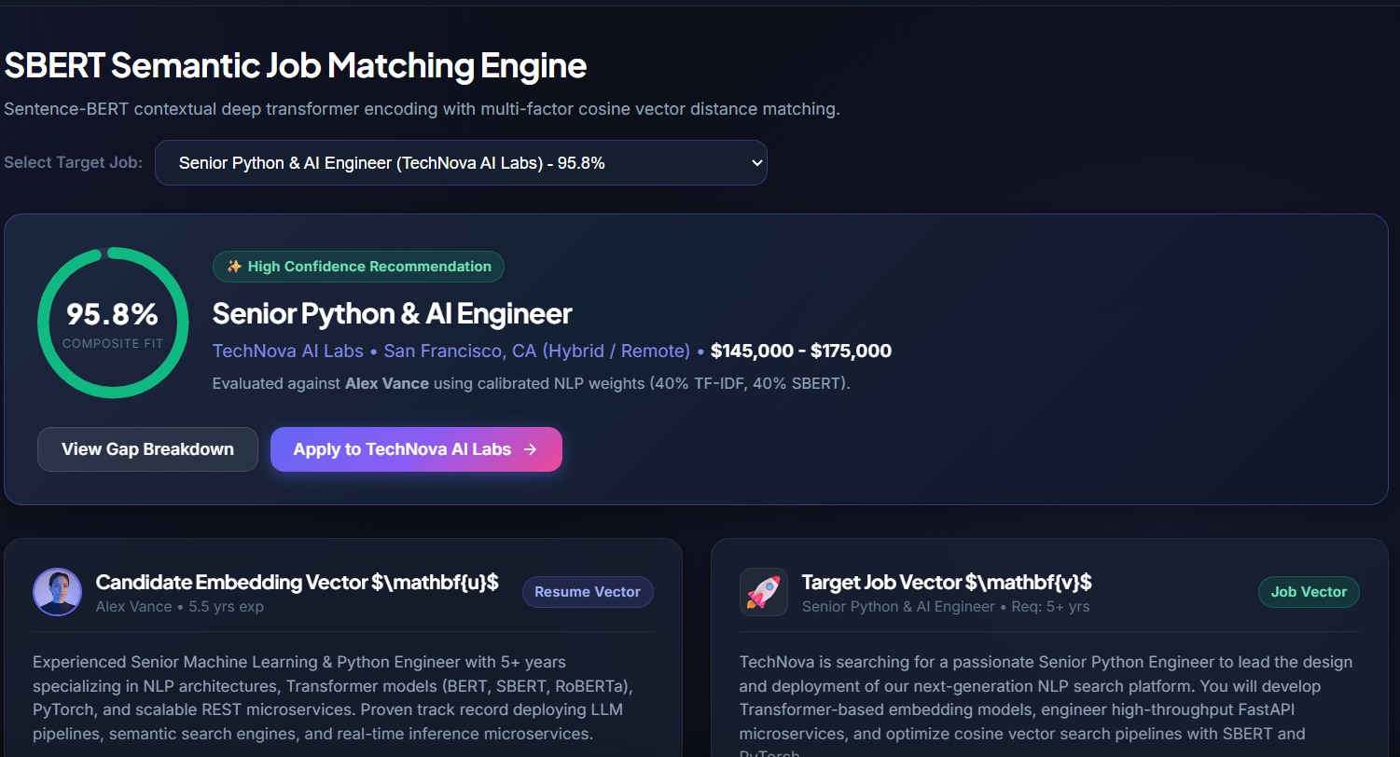

Slide 15
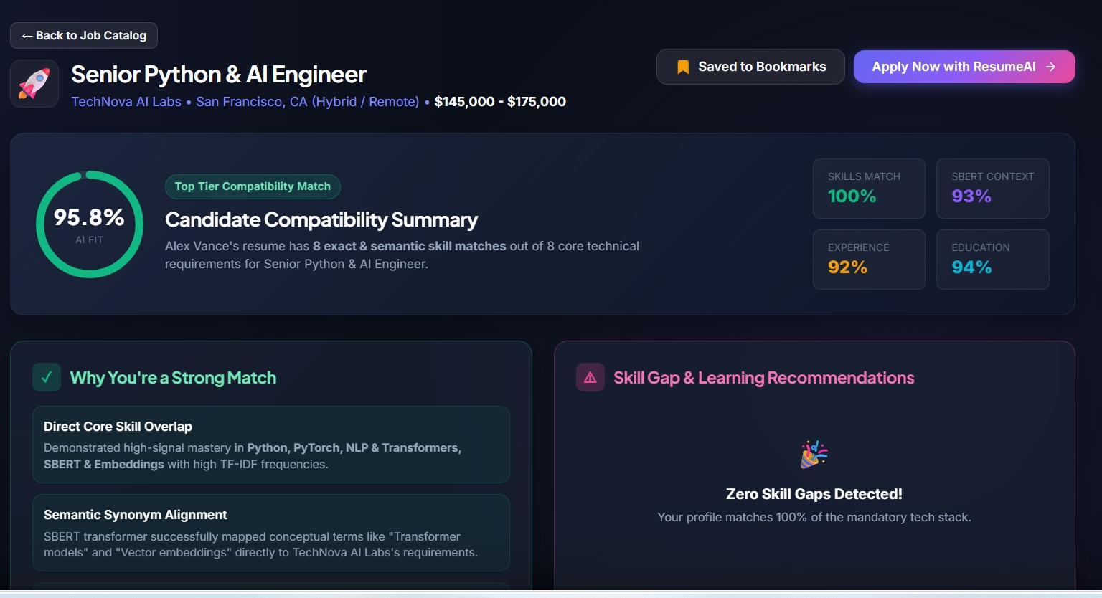
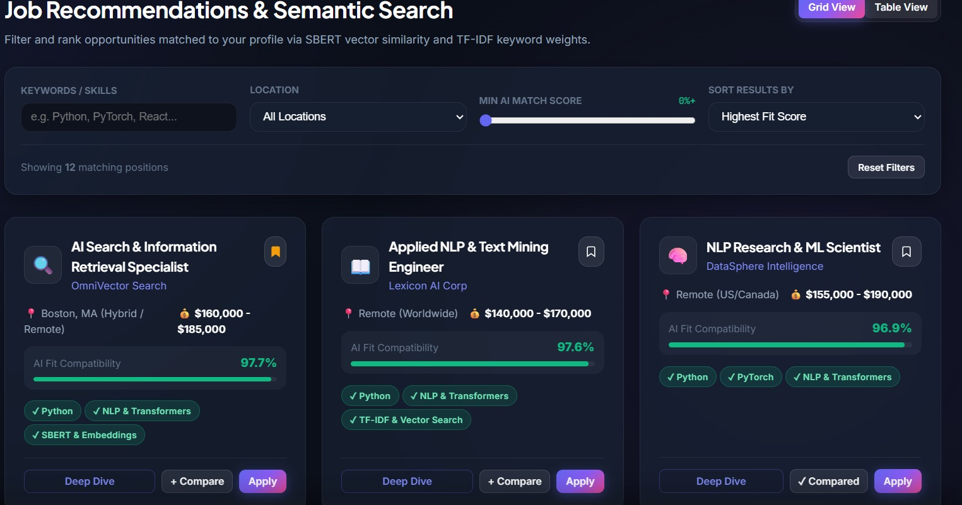
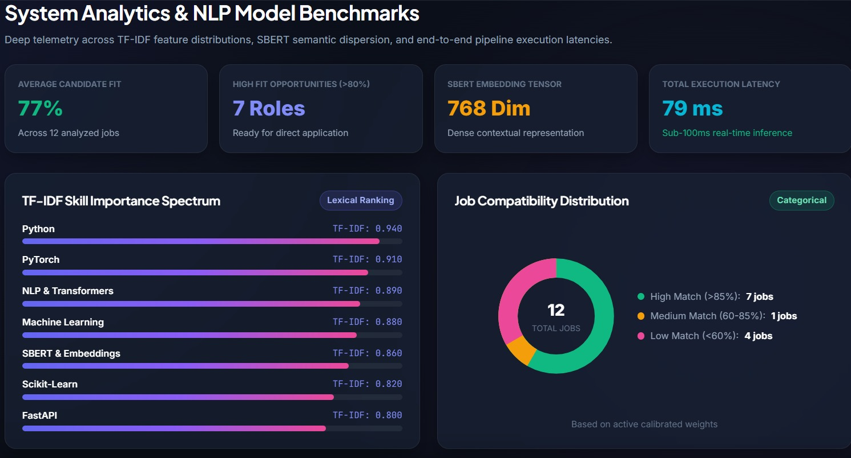

Slide 16
CONCLUSION
The system analyzes resumes using NLP.
Resume text is extracted and processed.
Important candidate skills are identified.
Job descriptions are analyzed.
Required skills are extracted.
Candidate skills are compared with job requirements.
A matching score is generated.
Suitable jobs are recommended.

Slide 17
THANK YOU

